Slide 1
VR Failure
Rover Vos

Slide 3
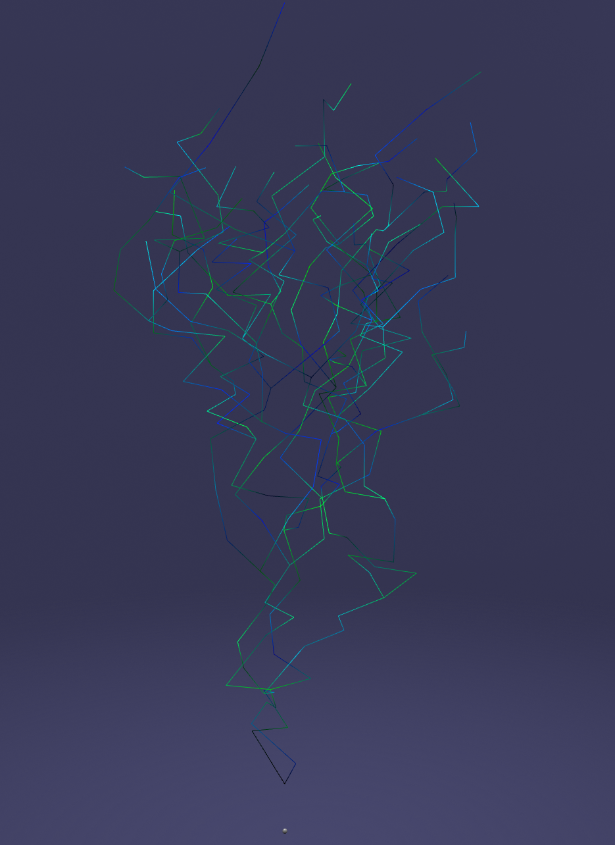


Slide 4
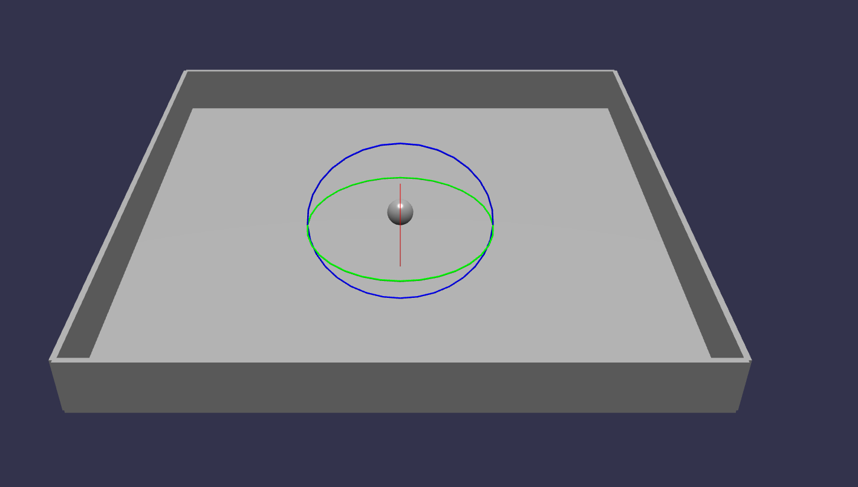

Slide 5


Slide 6
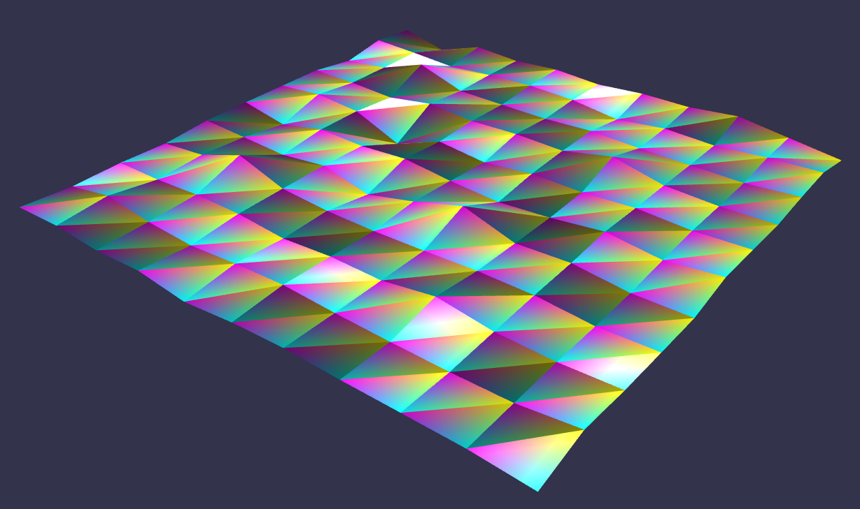

Slide 7
Things I learned along the way
VR is very different
VR without a headset is hard
Even if your working in 3D try to work in 2D makes it easier
Babylon.js is interesting, but not very broadly used

